Slide 1
Waze Part II : Digging into Key Ideas
KHEDHER Abdessalem, MILAVET Maxime, BERTI Charles

Slide 2
Idea 1: Manage the Unexpected

Slide 3
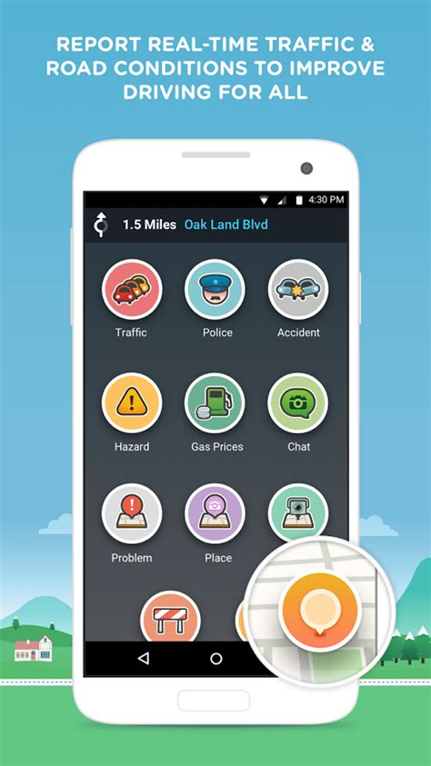
Explanation of the principle
When a user gets caught into a very slow road axis, the app sends a message to Waze servers to inform of the slow traffic. Waze then adapt the route of its users to equilibrate the traffic.
The principle relies on reactive operation : people get caught in traffic jams, but as they all share informations, others won’t be trapped.

Slide 4
Idea 2: User-oriented services

Slide 5
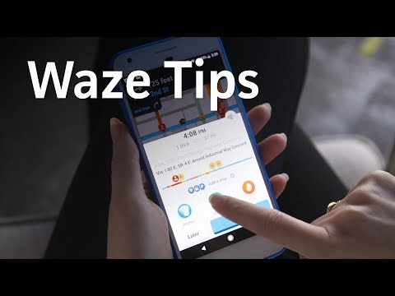
Waze for the user
Waze presents several user-oriented features:
Calculating the best departing time depending on the traffic in order to arrive at a setted time at the designated place.
Coordinate travelling with several cars
Find places for stationing
…

Slide 6
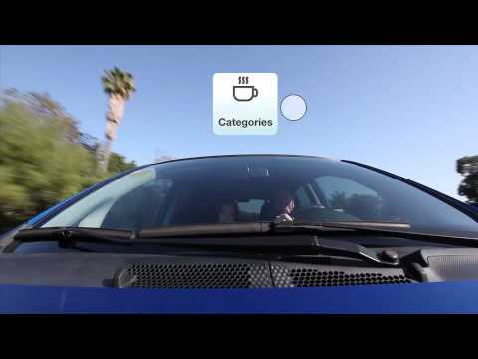
Waze Fuel
Waze allows the users to check the fuel stations, restaurants or others point of interests along their route.
Wazers can get discounts thanks to Waze negotiating deals.

Slide 7
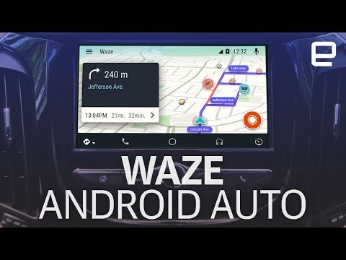
Waze for Android Auto
Providing a service specially adapted for lone drivers integrated to the user’s car :
Quick, wide screen, easy, hands-free

Slide 8
Idea 3: States can improve cities infrastructures via Benchmarking

Slide 9
Explanation of the principle
Users can give a mark to the general traffic in a city/area. This kind of data can be useful to the governementals of the city for instance.
For instance Jacksonville was deemed as a bad city for trafficas shown on this website. But with Waze real-time traffic it is possible to do much more : The company initiated the Connected Citizen Programm which works with local governments and companies to have access improving for instance rescuing time for accidents or allowing to study and improve traffic (video on next slide).

Slide 10
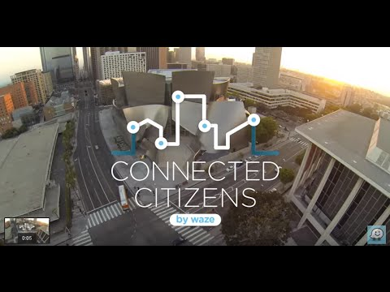
Connected Citizens Program
https://www.waze.com/fr/ccp

Slide 11
Idea 4: Passive use of the User

Slide 12
Explanation of the principle
Last but not least : the passive implication of the user. In many applications of massive innovation, the consumer has to do something to improve the system. On Wikipedia, a user must add an article to improve the database, for example. It’s the same thing with waze : the user must press alert buttons to improve the traffic.
But Waze can guess if you’re in trouble or not : it’s a GPS app, so it knows your speed. This way, users don’t have to be active to improve the sysem : they can just use the app and focus on driving, Waze takes care about the « Real Time » part of the traffic

Slide 13
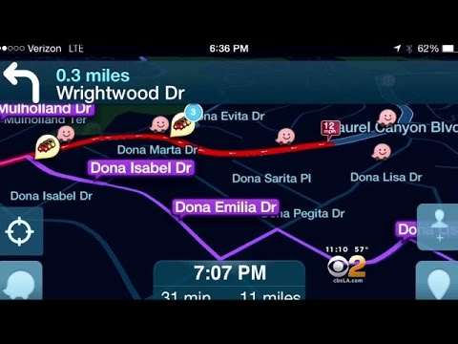
Exemple : false report dealing
There has been case of Wazers reporting false information on purpose : yet Waze was able to determine the falsety of the report

Slide 14
Sources
YouTube :
Waze Fuel https://youtu.be/2gkuo7N-slw
Waze for Android Auto https://youtu.be/U6-Ytlbz3Po
5 reasons why https://youtu.be/4hT0dPY5q-g
False congestion https://youtu.be/vk4JOjviW5s
Connected Citizens Programm https://youtu.be/kfy9IKQ7oBI
Long version https://youtu.be/z-_VjPesrMs
Waze:
Connected Citizens Programm https://www.waze.com/fr/ccp

